Slide 1




Social
Engineering Techniques

Slide 2


Social
Engineering
Social engineering is a method of using people as part of an attack process.
The goal of social engineering is to manipulate someone into doing something they would not otherwise do, without them realize they are being manipulated.

Slide 3
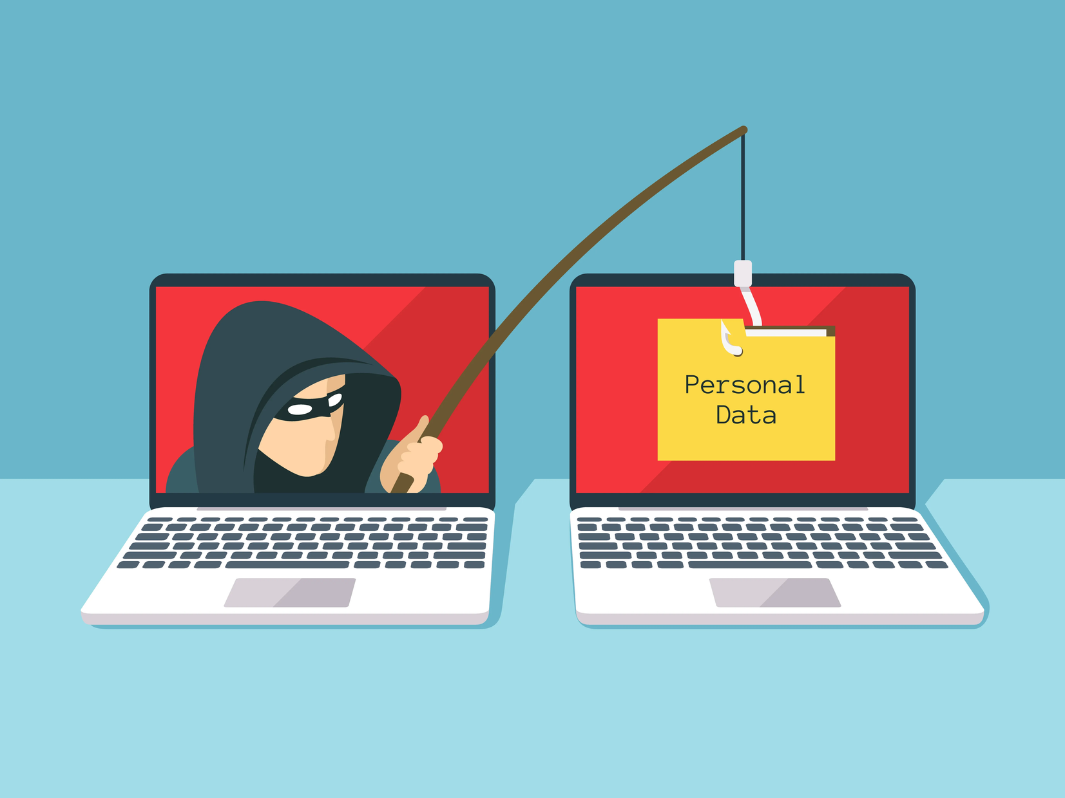
Phishing
Phishing is a type of social engineering in which an attacker attempts to obtain sensitive information from users by
masquerading as a trusted entity in an e-mail or instant message sent to a
large group of often random users.

Slide 4
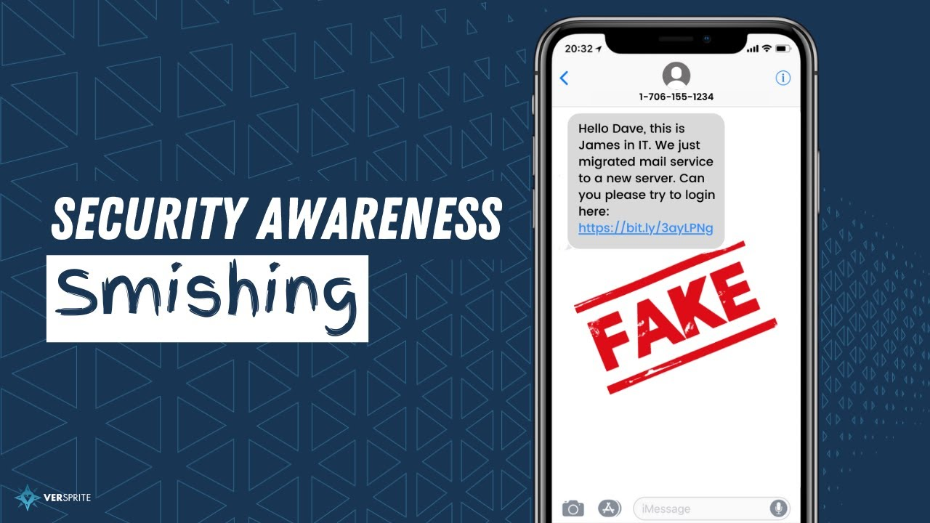
Smishing
Smishing is an attack using Short Message Service (SMS) on victims’ cell phones. It is a version of phishing via SMS. It begins with an SMS message directing a user to a URL that can serve up a variety of attack vectors, including forms of malware.

Slide 5

Vishing
Vishing is a variation of phishing that uses voice communication technology to obtain the information the attacker is seeking. Vishing takes advantage of the trust that some people place in the telephone network.

Slide 6

Spam
Spam is bulk unsolicited e-mail. Though not generally considered by many as a social engineering issue, or even a security issue for that matter, spam can still be a security concern

Slide 7

Spim
Though not as well known, a variation on spam is SPIM (Spam over Instant Messaging) , which is basically spam delivered via an instant messaging application. The purpose of hostile SPIM is the same as that of spam—getting an unsuspecting user to click malicious content or links, thus initiating the attack.

Slide 8
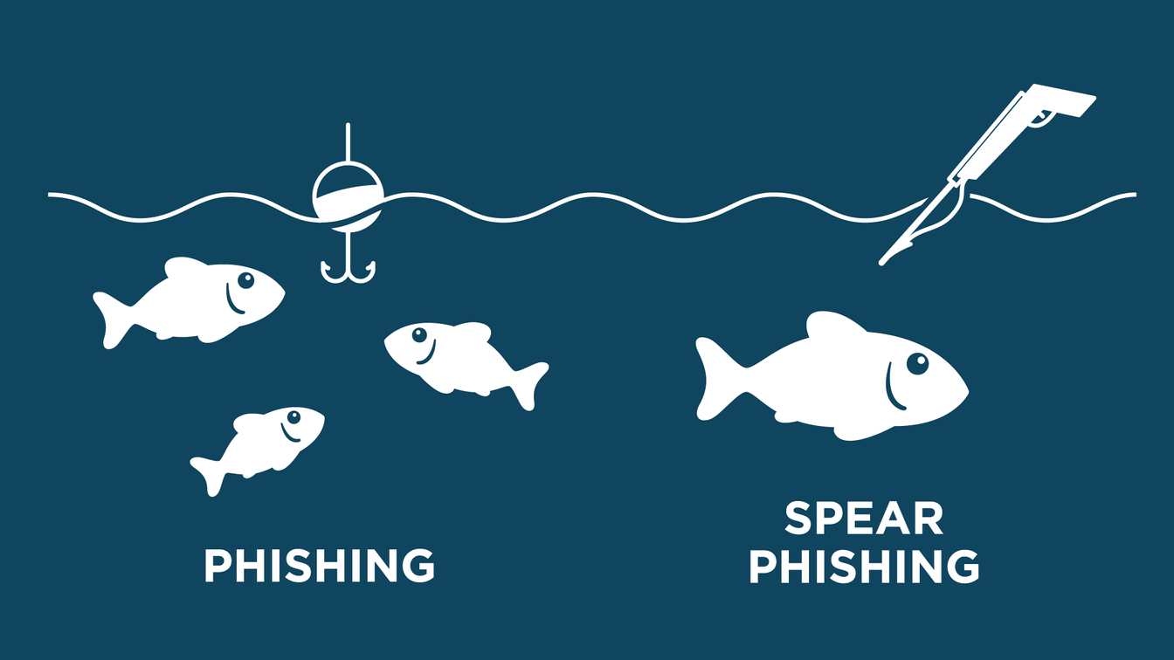
Spear Phishing
Spear phishing is a term created to refer to a phishing attack that targets a specific person or group of people with something in common

Slide 9

Dumpster Diving
Dumpster diving is the process of going through a target’s trash in hopes of finding valuable information that might be used in a penetration attempt is known in the security community.

Slide 10

Shoulder Surfing
Shoulder surfing does not necessarily involve direct contact with the target; instead, the attacker directly observes the individual entering sensitive information on a form, keypad, or keyboard.

Slide 11
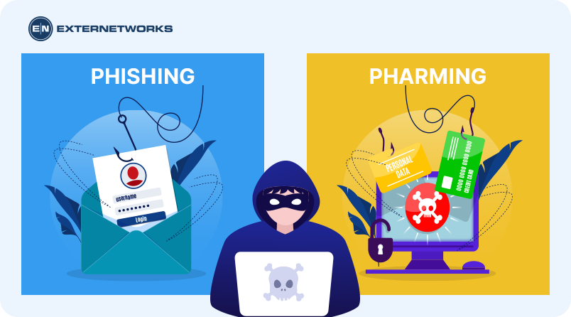
Pharming
Pharming consists of misdirecting users to fake websites made to look official. Using phishing, attackers target individuals, one by one, by sending out e-mails.

Slide 12
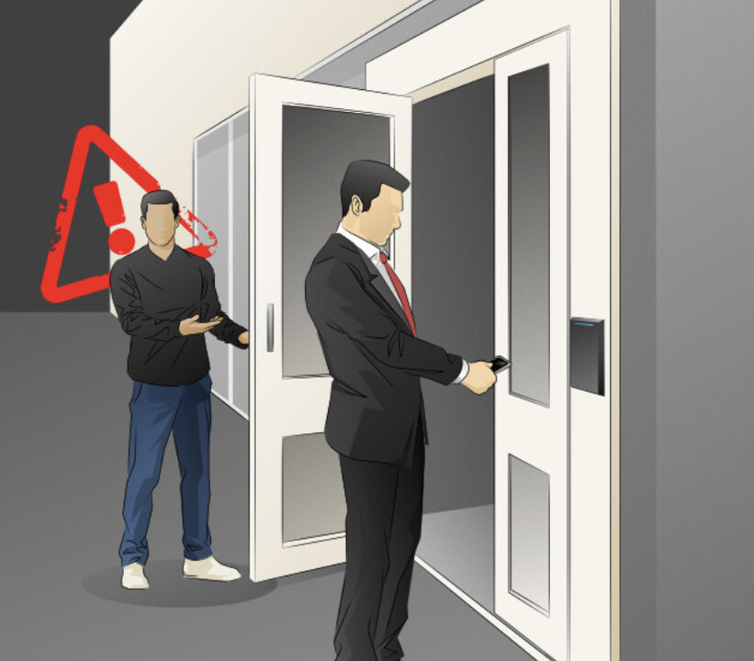
Tailgating
Tailgating (or piggybacking) is the simple tactic of following closely behind a person who has just used their own access card or PIN to gain physical access to a room or building.

Slide 13
Elicit Information Gathering
Elicit information gathering is using wide range of psychological techniques to convince people, whose main job is to help others, to perform tasks resulting in security compromises.

Slide 14

Whaling
Whaling attack is one where the target is a high-value person, such as a CEO or CFO. Whaling attacks are not performed by attacking multiple targets and hoping for a reply, but rather are custom built to increase the odds of success.

Slide 15
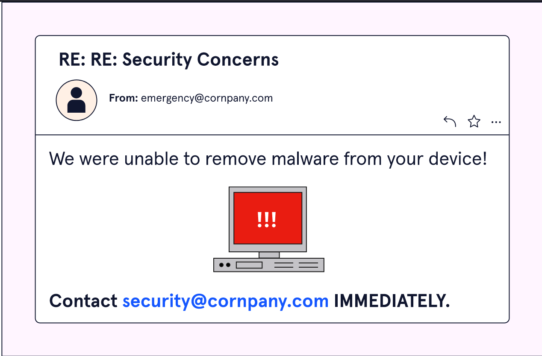
Prepending
Prepending is defined as the act of adding something else to the beginning of an item. When used in a social engineering context, prepending is the act of supplying information that another will act upon, frequently before they ask for it, in an attempt to legitimize the actual request, which comes later.

Slide 16

Identity Fraud
Identity fraud is the use of fake credentials to achieve an end. This can be high risk, pretending to be an official representative of a government agency or a regulator, or lower risk, showing up as the person who waters the plants.

Slide 17

Invoice Scams
Invoice scams use a fake invoice in an attempt to get a company to pay for things it has not ordered. The premise is simple: send a fake invoice and then get paid.

Slide 18
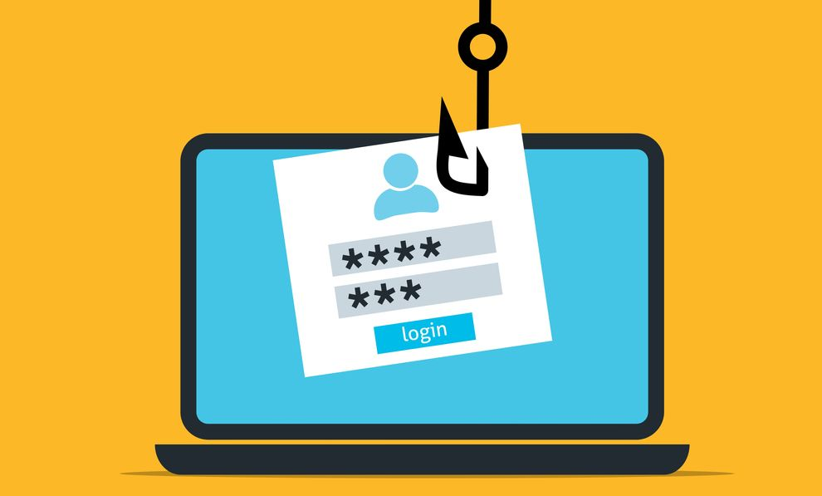
Credential Harvesting
Credential harvesting involves the collection of credential information, such as user IDs, passwords, and so on, enabling an attacker a series of access passes to the system. A common form of credential harvesting starts with a phishing e-mail that convinces a user to click a link and, in response, brings up a replica of their bank’s web page.

Slide 19

Reconnaissance
Reconnaissance is a military term used to describe the actions of surveying a battlefield to gain information prior to hostilities. In the field of cybersecurity, the concept is the same: an adversary will examine the systems they intend to attack, using a wide range of methods.

Slide 20
Hoax
Hoax can be very damaging if it causes users to take some sort of action that weakens security.

Slide 21
Impersonation
In the case of an impersonation attack, the attacker assumes a role that is recognized by the person being attacked, and in assuming that role, the attacker uses the potential victim’s biases against their better judgment to follow procedures.

Slide 22

Watering Hole Attack
Watering hole attack involves the infecting of a target website with malware. Watering hole attacks are complex to achieve and appear to be backed by nation-states and other high-resource attackers.

Slide 23

Typosquatting
Typosquatting is an attack form that involves capitalizing upon common typographical errors. If a user mistypes a URL, then the result should be a 404 error, or “resource not found.” But if an attacker has registered the mistyped URL, then the user would land on the attacker’s page. This attack pattern is also referred to as URL hijacking, fake URL, or brandjacking if the objective is to deceive based on branding.

Slide 24

Pretexting
Pretexting is a form of social engineering in which the attacker uses a narrative (the pretext) to influence the victim into giving up some item of information.

Slide 25
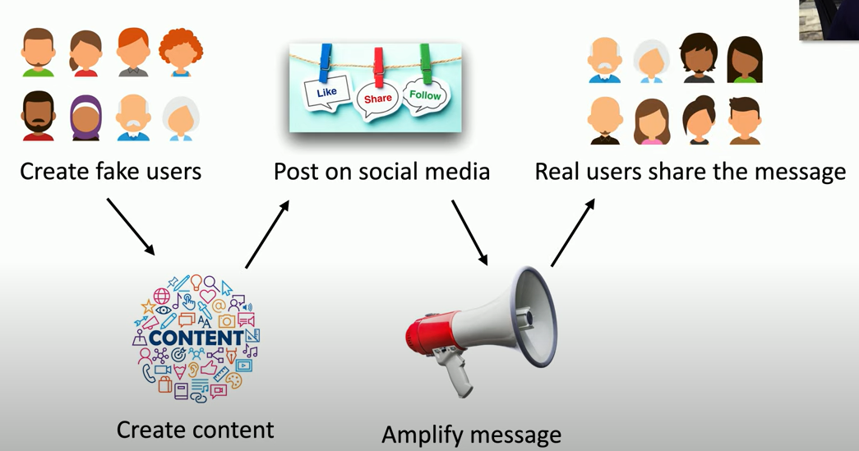
Influence Campaigns
Influence campaigns involve the use of collected information and selective publication of material to key individuals in an attempt to alter perceptions and change people’s minds on a topic.

Slide 26
Social
Engineering Principles
The use of authority in social situations can lead to an environment where one party feels at risk in challenging another over an issue.
Intimidation can be either subtle, through perceived power, or more direct, through the use of communications that build an expectation of superiority.
Consensus is a group-wide decision. It frequently comes not from a champion, but rather through rounds of group negotiation.
By giving the impression of scarcity (or short supply) of a desirable product, an attacker can motivate a target to make a decision quickly without deliberation.

Slide 27
Social
Engineering Principles
People do things for people they like or feel connected to. Building this sense of familiarity and appeal can lead to misplaced trust. The social engineer can focus the conversation on familiar items, not the differences
Trust is defined as having an understanding of how something will act under specific conditions. Social engineers can shape the perceptions of a target to where they will apply judgments to the trust equation and come to false conclusions.
Time can be manipulated to drive a sense of urgency and prompt shortcuts that can lead to opportunities for interjection into processes. Limited-time offers should always be viewed as suspect.

Slide 28
Social
Engineering Defenses
Stopping social engineering begins with policies and procedures that eliminate the pathways used by these attacks.
Visitor access, rules before assisting a customer, verifying requests as legitimate before sharing certain sensitive elements—these are all doable items.
Once you have layered policies and procedures to avoid these issues, or their outcomes, the critical element is employee training.
Maintaining vigilance on the part of employee actions is the challenge, and frequent reminders, retraining, and notification of violations can go a long way toward achieving the desired defense.
Lastly, have multiple layers of defenses, including approvals and related safeguards so that a single mistake from an employee will not give away the keys to the kingdom

Slide 29
Thank
You

